Slide 1

A Mini Project Report on
PRIVACY-PRESERVING ATTRIBUTE-BASED ACCESS CONTROL MODEL FOR XML-BASED ELECTRONIC HEALTH RECORD SYSTEM
Submitted to
Jawaharlal Nehru Technological University, Hyderabad in partial fulfillment of the requirements for the award of the degree
BACHELOR OF TECHNOLOGY
in
COMPUTER SCIENCE & ENGINEERING
by
Anshul Nandiraju (17831A0509)
Anthati Yamini (17831A0510)
Anugu Vineeth Reddy (17831A0512)
Under the Esteemed Guidance of
Mrs. Nagabotu Vimala
Assistant professor
DEPARTMENT OF COMPUTER SCIENCE & ENGINEERING
GURU NANAK INSTITUTE OF TECHNOLOGY
(Affiliated to JNTUH-Hyderabad)
Ranga Reddy District -501506

Slide 2
INTRODUCTION
Cloud-based electronic health record (EHR) systems enable medical documents to be exchanged between medical institutions; this is expected to contribute to improvements in various medical services in the future. However, as the system architecture becomes more complicated, cloud-based EHR systems may introduce additional security threats when compared to existing singular systems. Thus, patients may experience exposure of private data that they do not wish to disclose. In order to protect the privacy of patients, many approaches have been proposed to provide access control to patient documents when providing health services. However, most current systems do not support fine-grained access control or take into account additional security factors such as encryption and digital signatures. In this project, we propose a cloud-based EHR model that performs attribute-based access control using extensible access control markup language. Our EHR model, focused on security, performs partial encryption and uses electronic signatures when a patient document is sent to a document requester. We use XML encryption and XML digital signature technology. Our proposed model works efficiently by sending only the necessary information to requesters who are authorized to treat the patient in question.

Slide 3
ABSTRACT
Millions of private images are generated in various digital devices every day. The consequent massive computational workload makes people turn to cloud computing platforms for their economical computation resources. Meanwhile, the privacy concerns over the sensitive information contained in outsourced image data arise in public. In fact, once uploaded to cloud, the security and privacy of the image content can only presume upon the reliability of the cloud service providers. Lack of assuring security and privacy guarantees becomes the main barrier to further deployment of cloud-based image processing systems. This project studies the design targets and technical challenges lie in constructing cloud-based privacy-preserving image processing system. We explore various image processing tasks, including image feature detection, digital watermarking, content-based image search. The state-of-the-art techniques, including secure multiparty computation, and homomorphic encryption are investigated. A detailed taxonomy of the problem statement and the corresponding solutions is provided.

Slide 4
KEYWORDS
S.NO | KEYWORDS | EXPANSION
1. | DB | Database
2. | JVM | Java Virtual Machine
3. | JSP | Java Server Page
4. | LCA | Lowest Common Ancestor
5. | ELCA | Exclusive Lowest Common Ancestor
6. | JRE | Java Runtime Environment
7. | MCTs | Minimal Cost Trees
8. | SLCA | Smallest Lowest Common Ancestor

Slide 5
SCOPE OF THE PROJECT
We proposed a cloud-based EHR model that guarantees patient privacy. The proposed model is divided into two stages: access control, and the application of encryption and digital signatures. The proposed model uses an ABAC method built upon XACML. After performing access control on patient documents, encryption is performed and digital signatures are added using XML encryption and XML digital signatures as an added security measure. The proposed model provides more flexible and fine-grained control than existing RBAC systems and alleviates the risk of exposing patient privacy information by using partial encryption and electronic signatures. The implementation of a prototype demonstrated the feasibility of the proposed model. We compared the implemented security factors with those used in other related studies and determined that the proposed method is superior to previous methods in terms of security.

Slide 6
LITERATURE SURVEY
Title: Personal health records: definitions, benefits, and strategies for overcoming barriers to adoption.
Author: Tang PC, Ash JS, Bates DW, Overhage JM, Sands DZ.
Year:2016
Description:
Recently there has been a remarkable upsurge in activity surrounding the adoption of personal health record (PHR) systems for patients and consumers. The biomedical literature does not yet adequately describe the potential capabilities and utility of PHR systems. In addition, the lack of a proven business case for widespread deployment hinders PHR adoption. In a 2015 working symposium, the American Medical Informatics Association's College of Medical Informatics discussed the issues surrounding personal health record systems and developed recommendations for PHR-promoting activities. Personal health record systems are more than just static repositories for patient data; they combine data, knowledge, and software tools, which help patients to become active participants in their own care. When PHRs are integrated with electronic health record systems, they provide greater benefits than would stand-alone systems for consumers. This project summarizes the College Symposium discussions on PHR systems and provides definitions, system characteristics, technical architectures, benefits, barriers to adoption, and strategies for increasing adoption.

Slide 7
Title: Key capabilities of an electronic health record system.
Author: Institute of Medicine (US) Committee on Data Standards for Patient Safety.
Washington (DC):
Year:2018
Description:
Commissioned by the Department of Health and Human Services, Key Capabilities of an Electronic Health Record System provides guidance on the most significant care delivery-related capabilities of electronic health record (EHR) systems. There is a great deal of interest in both the public and private sectors in encouraging all health care providers to migrate from paper-based health records to a system that stores health information electronically and employs computer-aided decision support systems. In part, this interest is due to a growing recognition that a stronger information technology infrastructure is integral to addressing national concerns such as the need to improve the safety and the quality of health care, rising health care costs, and matters of homeland security related to the health sector. Key Capabilities of an Electronic Health Record System provides a set of basic functionalities that an EHR system must employ to promote patient safety, including detailed patient data (e.g., diagnoses, allergies, laboratory results), as well as decision-support capabilities (e.g., the ability to alert providers to potential drug-drug interactions). The book examines care delivery functions, such as database management and the use of health care data standards to better advance the safety, quality, and efficiency of health care in the United States.

Slide 8
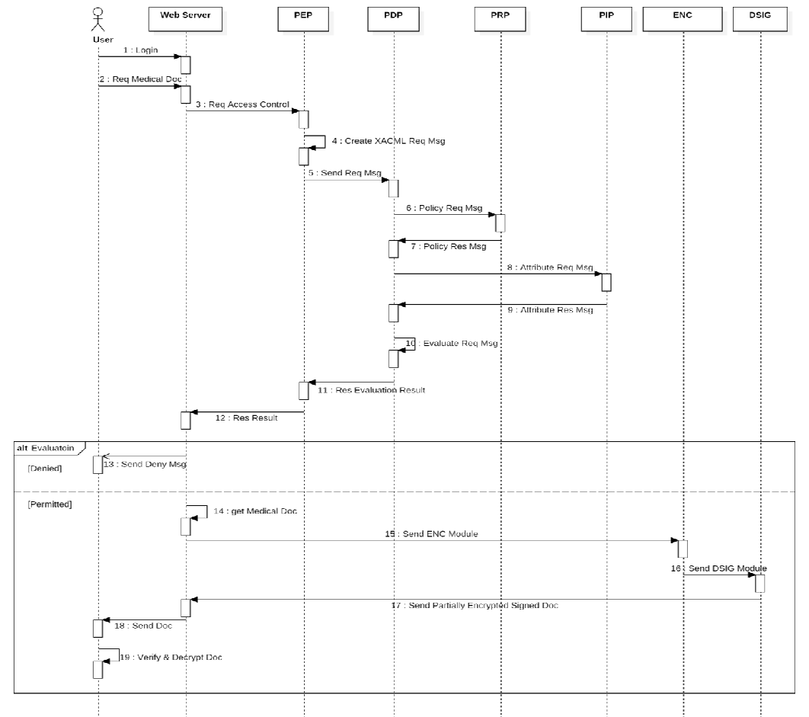
ARCHITECTURE MODEL

Slide 9
HARDWARE REQUIREMENTS
PROCESSOR : PENTIUM IV 2.6 GHz, Intel Core 2 Duo.
RAM : 4GB DD RAM
MONITOR : 15” LCD,LED MONITOR
HARD DISK : 40 GB
SOFTWARE REQUIREMENTS
FRONT END : J2EE (JSP, SERVLET)
BACK END : MY SQL 5.5
OPERATING SYSTEM : WINDOWS 7
IDE : ECLIPSE

Slide 10
EXISTING SYSTEM
Cloud-based electronic health record (EHR) systems enable medical documents to be exchanged between medical institutions.
Cloud-based EHR systems may introduce additional security threats when compared to existing singular systems.
EXISTING SYSTEM DISADVANTAGES
Hash collisions are practically unavoidable.
When hashing a random subset of a large set of possible keys.
Hash tables become quite inefficient when there are many collisions.

Slide 11
MODULES
In this project we have the following modules.
User Interface Design
Electronic Health Record System
User
Admin

Slide 12
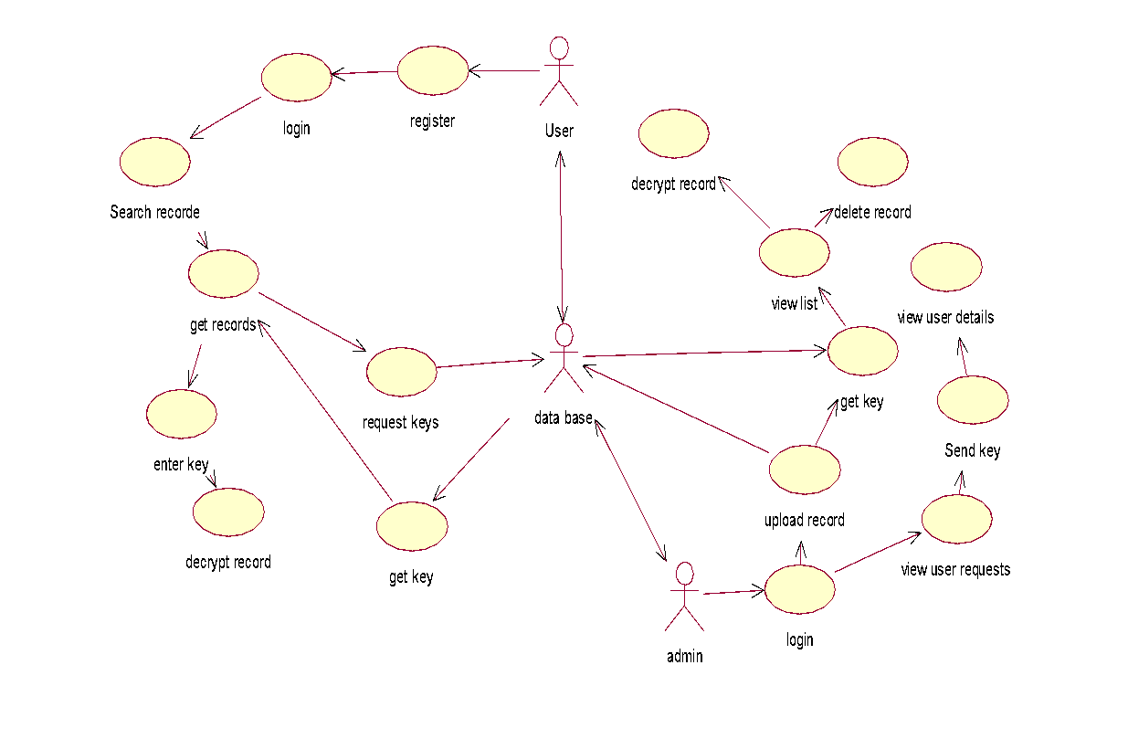
UML DIAGRAMS
USE CASE DIAGRAM:

Slide 13
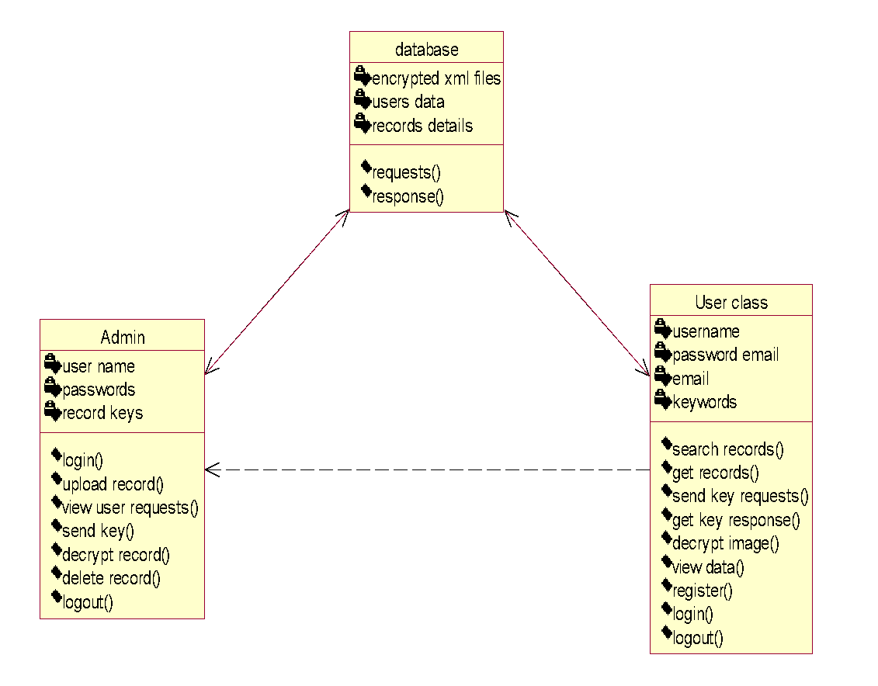
CLASS DIAGRAM:

Slide 14
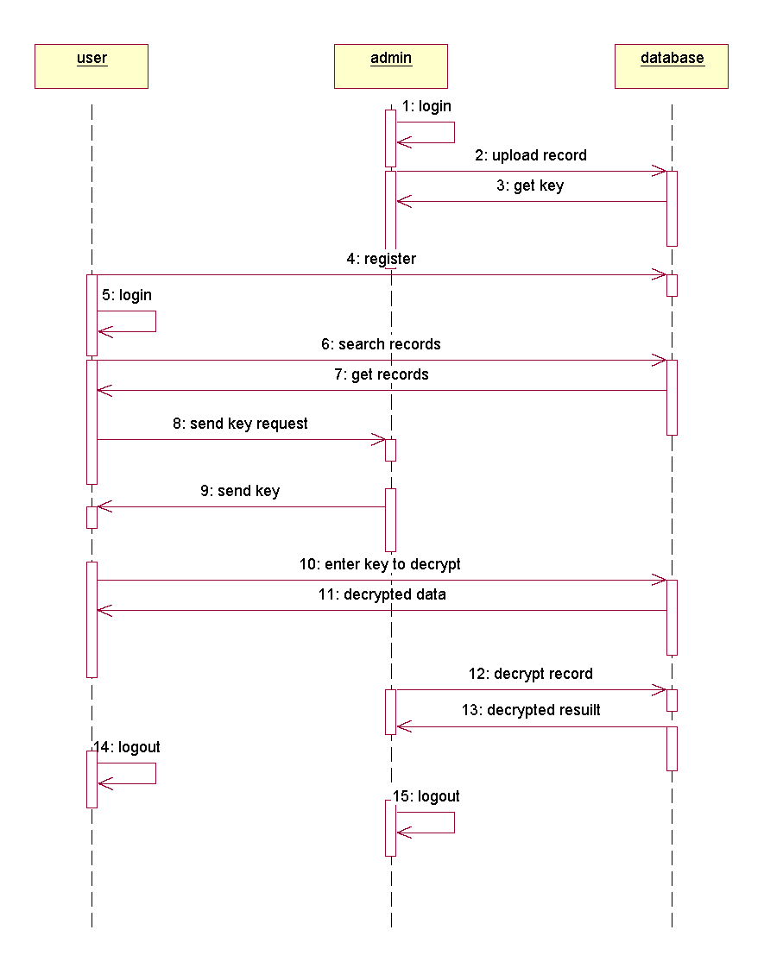
SEQUENCE DIAGRAM:

Slide 15
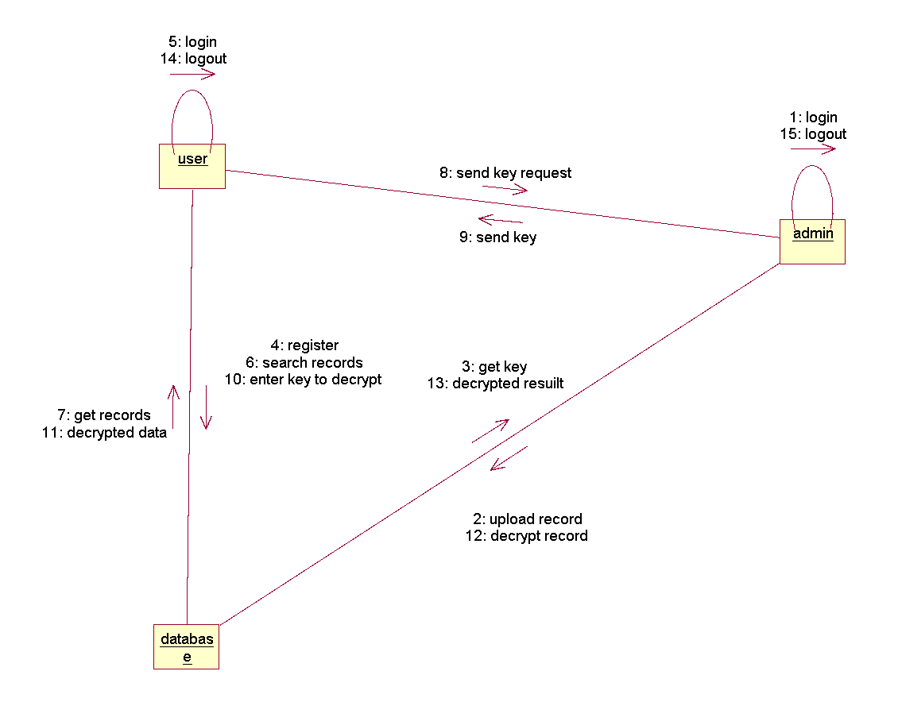
COLLABORATION DIAGRAM:

Slide 16
DATA FLOW DIAGRAM
Level-0:
Normal User
User
Register
Admin
Login
Login
Valid
Database
Homepage
Error page/Login page

Slide 17
Level-1:
Enter key
Get records
Searching records
User
Decrypt record
Database
Send key
View key requests
Upload data
Admin
Decrypt records
Delete records

Slide 18
DB Design:
name
uid
keys
email
User
If valid user
Gender
password
Mobile
Database
User name
password
Admin
If have records
XML record
records
keys
data
rid
title
keywords

Slide 19
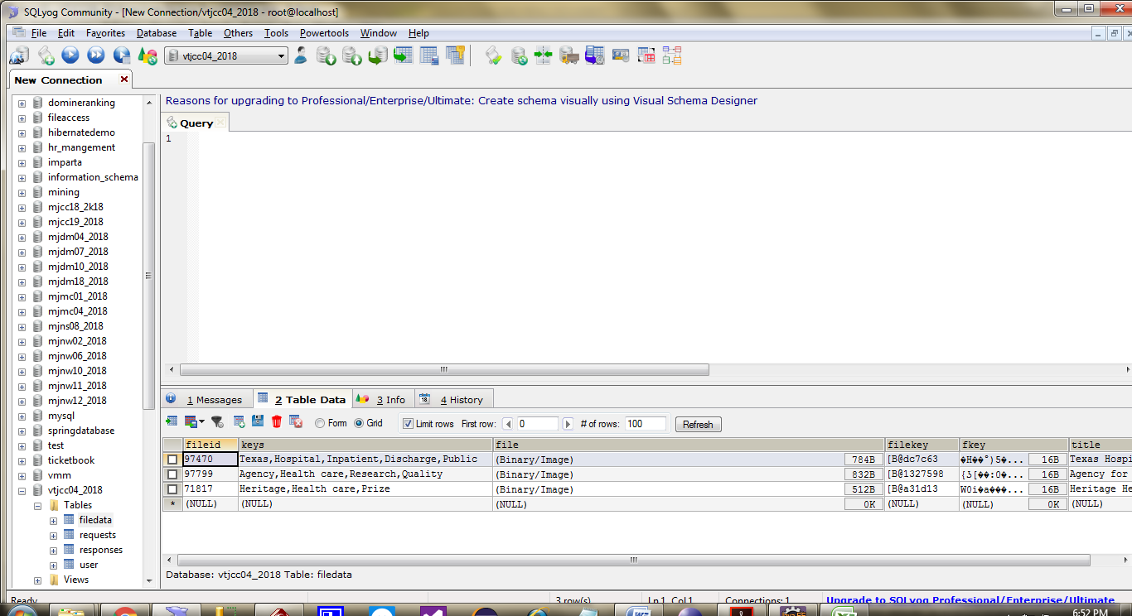
Database Structure:

Slide 20
DEVELOPMENT TOOLS
GENERAL
This chapter is about the software language and the tools used in the development of the project. The platform used here is JAVA. The Primary languages are JAVA,J2EE and J2ME. In this project J2EE is chosen for implementation.
FEATURES OF JAVA
THE JAVA FRAMEWORK
Java is a programming language originally developed by James Gosling at Microsystems and released in 1995 as a core component of Sun Microsystems' Java platform. Java applications are typically compiled to byte code that can run on any Java Virtual Machine (JVM) regardless of computer architecture. Java is general-purpose, concurrent, class-based, and object-oriented, and is specifically designed to have as few implementation dependencies as possible. It is intended to let application developers "write once, run anywhere".
Java is considered by many as one of the most influential programming languages of the 20th century, and is widely used from application software to web applications the java framework is a new platform independent that simplifies application development internet. From laptops to datacenters, game consoles to scientific supercomputers, cell phones to the Internet, Java is everywhere!

Slide 21
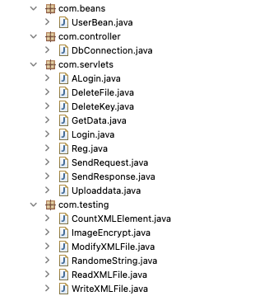
BACKEND CODE:

Slide 22
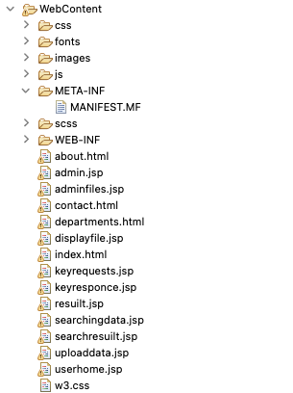
FRONTEND CODE:

Slide 23
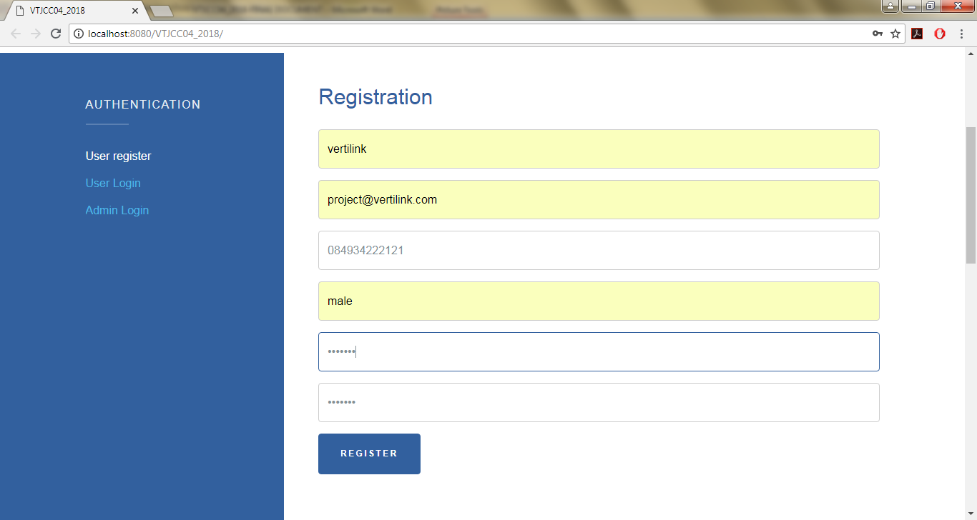
SCREENSHOTS

Slide 24
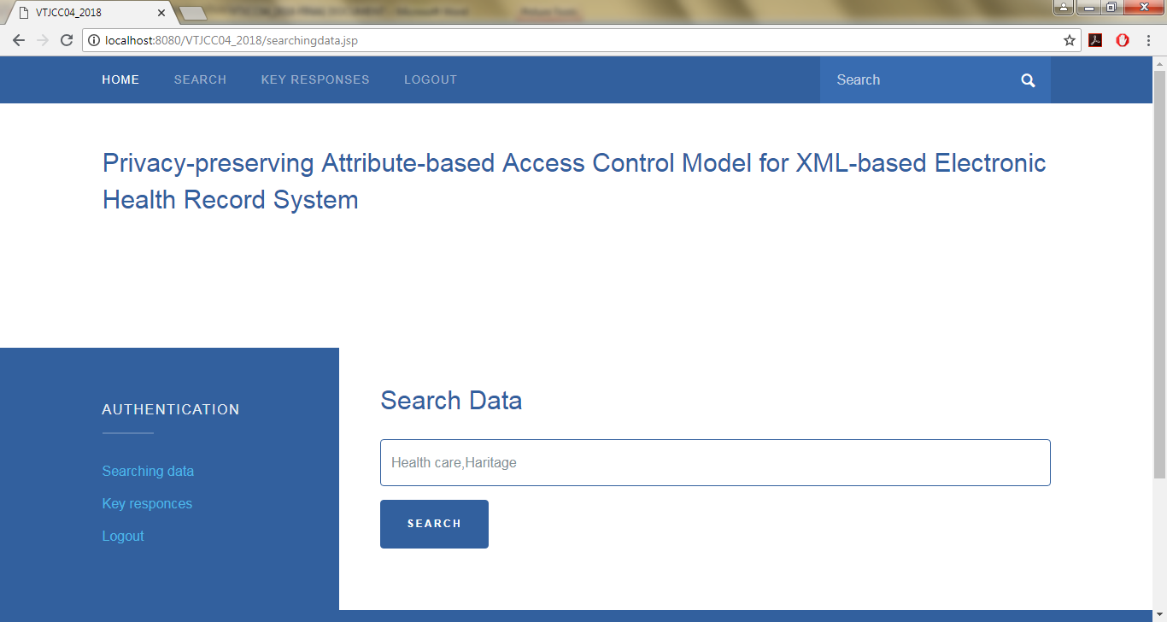
Screenshot 1

Slide 25
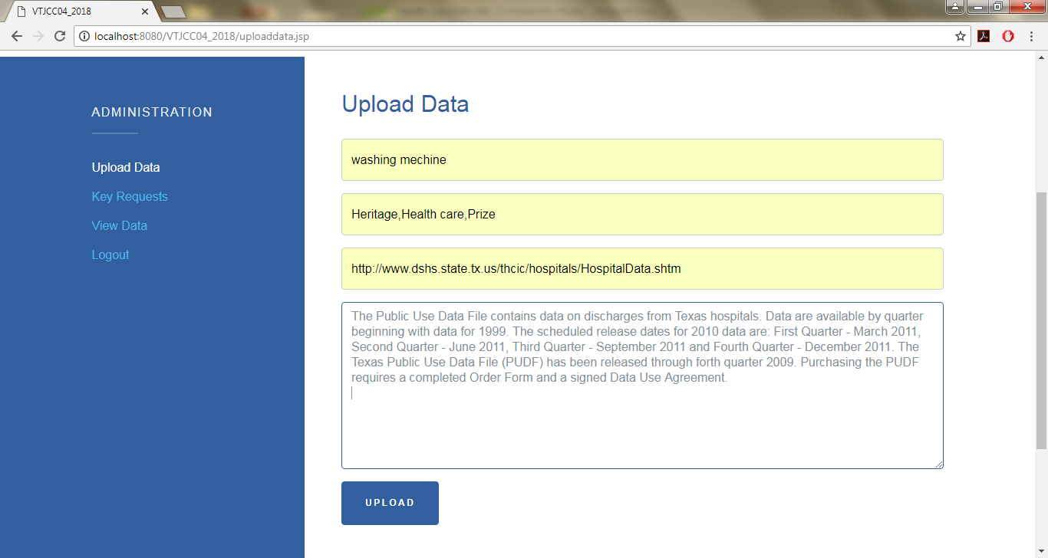
Screenshot 2

Slide 26
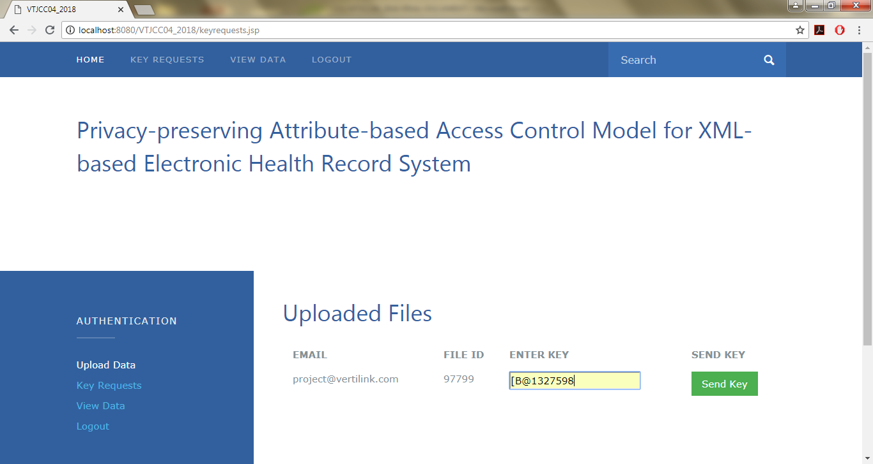
Screenshot 3

Slide 27
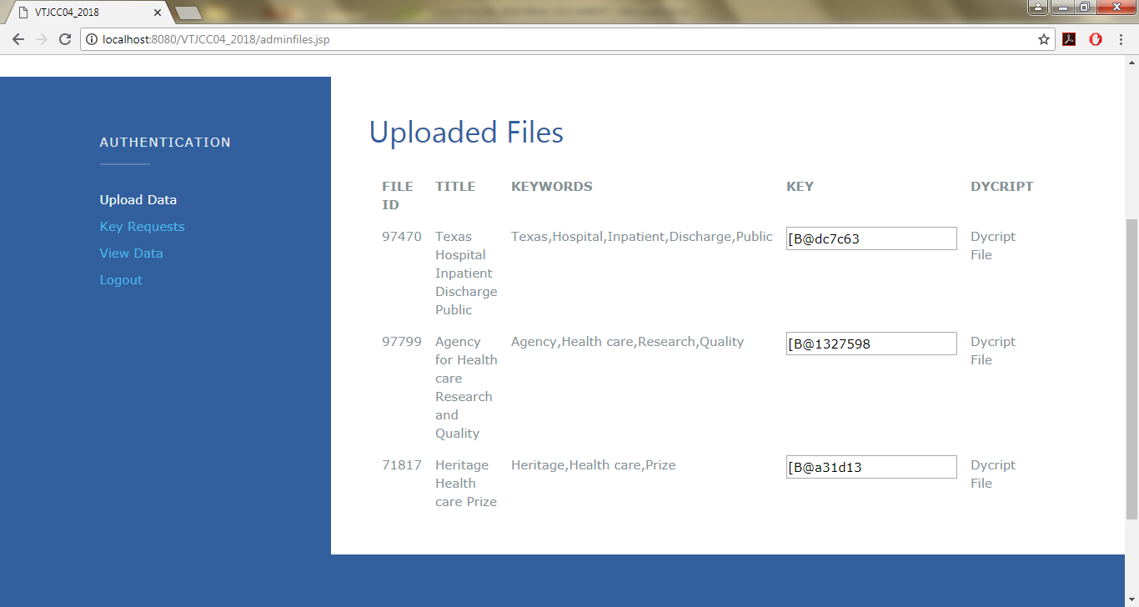
Screenshot 4

Slide 28
TESTING
8.3Types of Tests Performed
8.3.1 Unit testing
Unit testing involves the design of test cases that validate that the internal program logic is functioning properly, and that program input produce valid outputs. All decision branches and internal code flow should be validated. It is the testing of individual software units of the application .it is done after the completion of an individual unit before integration. This is a structural testing, that relies on knowledge of its construction and is invasive. Unit tests perform basic tests at component level and test a specific business process, application, and/or system configuration. Unit tests ensure that each unique path of a business process performs accurately to the documented specifications and contains clearly defined inputs and expected results.

Slide 29
TESTING
8.3.2 Functional test
Functional tests provide systematic demonstrations that functions tested are available as specified by the business and technical requirements, system documentation, and user manuals.
Functional testing is centered on the following items:
Valid Input : identified classes of valid input must be accepted.
Invalid Input : identified classes of invalid input must be rejected.
Functions : identified functions must be exercised.
Output : identified classes of application outputs must be exercised.
Systems/Procedures : interfacing systems or procedures must be invoked.
8.3.3 System Test
System testing ensures that the entire integrated software system meets requirements. It tests a configuration to ensure known and predictable results. An example of system testing is the configuration oriented system integration test. System testing is based on process descriptions and flows, emphasizing pre-driven process links and integration points.

Slide 30
TESTING
8.3.4 Performance Test
The Performance test ensures that the output be produced within the time limits,and the time taken by the system for compiling, giving response to the users and request being send to the system for to retrieve the results.
8.3.5 Integration Testing
Software integration testing is the incremental integration testing of two or more integrated software components on a single platform to produce failures caused by interface defects.
The task of the integration test is to check that components or software applications, e.g. components in a software system or – one step up – software applications at the company level – interact without error.

Slide 31
User Registration Test:
Test Scenarios | Test Steps | Test Data | Expected Results | Success/Failure
Check user registration with valid data | Enter username Enter Email Phone no. Gender Password Confirm password | Anshul Anshul123@gmail.com 9676124490 Male 123 123 | User registration successful | Success
Check user registration with invalid data | Invalid Data | Invalid Data | Registration Failed | Success

Slide 32
User Login and Admin Login Test:
Test Scenarios | Test Steps | Test Data | Expected Results | Success/Failure
Check user Login with valid data | Enter User Enter Password | Anshul 123 | User Login successful | Success
Check user Login with invalid data | Invalid Data | Invalid Data | Login Failed | Success
Test Scenarios | Test Steps | Test Data | Expected Results | Success/Failure
Check Admin Login with valid data | Enter User Enter Password | Admin admin | Admin Login successful | Success
Check Admin Login with invalid data | Invalid Data | Invalid Data | Login Failed | Success

Slide 33
FUTURE ENHANCEMENT:
In the future, we will further refine the processes used in the proposed model and implement additional security features. We will also expand the implementation of the prototype to implement a more refined system and perform quantitative performance evaluation.
CONCLUSION:
In this Project, we proposed a cloud-based EHR model that guarantees patient privacy. The proposed model is divided into two stages: access control, and the application of encryption and digital signatures. The proposed model uses an ABAC method built upon XACML. After performing access control on patient documents, encryption is performed and digital signatures are added using XML encryption and XML digital signatures as an added security measure. The proposed model provides more flexible and fine-grained control than existing RBAC systems and alleviates the risk of exposing patient privacy information by using partial encryption and electronic signatures. The implementation of a prototype demonstrated the feasibility of the proposed model. We compared the implemented security factors with those used in other related studies and determined that the proposed method is superior to previous methods in terms of security.

Slide 34
REFERENCE:
[1] Tang, P. C., Ash, J. S., Bates, D. W., Overhage, J. M., & Sands, D. Z. (2016). Personal health records: definitions, benefits, and strategies for overcoming barriers to adoption. Journal of the American Medical Informatics Association, [Online]. 13(2), 121-126. Available: https://academic.oup.com/jamia/article/13/2/121/729326/Personal-Health-Records-Definitions-Benefits-and
[2] Waegemann, C. P. (2003). Ehr vs. cpr vs. emr. Healthcare Informatics Online, [Online]. 1, 1-4. Available: https://pdfs.semanticscholar.org/ce2f/cf783c1fa2afdaa81c5a46c317e7edff04bc.pdf
[3] van der Linden, H., Kalra, D., Hasman, A., & Talmon, J. (2019). Inter-organizational future proof EHR systems: a review of the security and privacy related issues. International journal of medical informatics, [Online]. 78(3), 141-160. Available: http://www.sciencedirect.com/science/article/pii/S1386505608001081
[4] Tang, P. C. (2013). Key capabilities of an electronic health record system. Washington, DC, Institute of Medicine of the National Academies. [Online]. Available: http://www.nationalacademies.org/hmd/Reports/2003/Key-Capabilities-of-an-Electronic-Health-Record-System.aspx

Slide 35
[5] Miller, R. H., West, C., Brown, T. M., Sim, I., & Ganchoff, C. (2015). The value of electronic health records in solo or small group practices. Health Affairs, [Online]. 24(5), 1127-1137. Available: http://content.healthaffairs.org/content/24/5/1127.short
[6] Middleton, B., Bloomrosen, M., Dente, M. A., Hashmat, B., Koppel, R., Overhage, J. M., ... & Zhang, J. (2013). Enhancing patient safety and quality of care by improving the usability of electronic health record systems: recommendations from AMIA. Journal of the American Medical Informatics Association, [Online]. 20(e1), e2-e8. Available: https://academic.oup.com/jamia/article/20/e1/e2/692244/Enhancing-patient-safety-and-quality-of-care-by
[7] Simon, S. R., Kaushal, R., Cleary, P. D., Jenter, C. A., Volk, L. A., Poon, E. G., ... & Bates, D. W. (2017). Correlates of electronic health record adoption in office practices: a statewide survey. Journal of the American Medical Informatics Association, [Online]. 14(1), 110-117. Available: https://academic.oup.com/jamia/article/14/1/110/746202/Correlates-of-Electronic-Health-Record-Adoption-in
[8] Ratnam, K. A., & Dominic, P. D. D. (2012, June). Cloud services-Enhancing the Malaysian healthcare sector. In Computer & Information Science (ICCIS), 2012 International Conference on. [Online]. Available: http://ieeexplore.ieee.org/abstract/document/6297101/
[9] Zhang, R., & Liu, L. (2019, July). Security models and requirements for healthcare application clouds. In Cloud Computing (CLOUD), 2010 IEEE 3rd International Conference on. [Online]. Available: http://ieeexplore.ieee.org/abstract/document/5557983/

Slide 36
[10] Benaloh, J., Chase, M., Horvitz, E., & Lauter, K. (2019, Nov.). Patient controlled encryption: ensuring privacy of electronic medical records. In Proceedings of the 2009 ACM workshop on Cloud computing security. [Online]. Available: http://dl.acm.org/citation.cfm?id=1655024
[11] Ray, P., & Wimalasiri, J. (2016, Aug.). The need for technical solutions for maintaining the privacy of EHR. In Engineering in Medicine and Biology Society, 2006. EMBS'06. 28th Annual International Conference of the IEEE. [Online]. Available: http://ieeexplore.ieee.org/abstract/document/4462848/
[12] Abbas, A., & Khan, S. U. (2014). A review on the state-of-the-art privacy-preserving approaches in the e-health clouds. IEEE Journal of Biomedical and Health Informatics, [Online]. 18(4), 1431-1441. Available: http://ieeexplore.ieee.org/abstract/document/6714376/
[13] Extensible Access Control Markup Language (XACML) Version 3.0, OASIS Standard, 22 Jan. 2013, Available: http://docs.oasis-open.org/xacml/3.0/xacml-3.0-core-spec-os-en.html
[14] XML Encryption Syntax and Processing, W3C Recommendation, 10 Dec 2012, Available: http://www.w3.org/TR/xmlenc-core/.
[15] Standards for Privacy of Individually Identifiable Health Information: Final Rule. Dec. 28, 2010.

Slide 37


